Slide 1
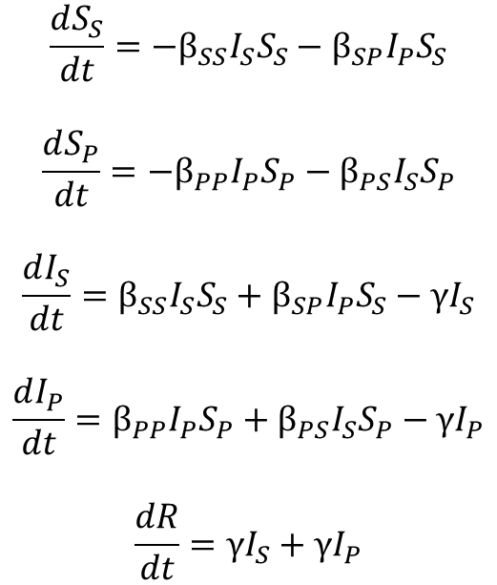
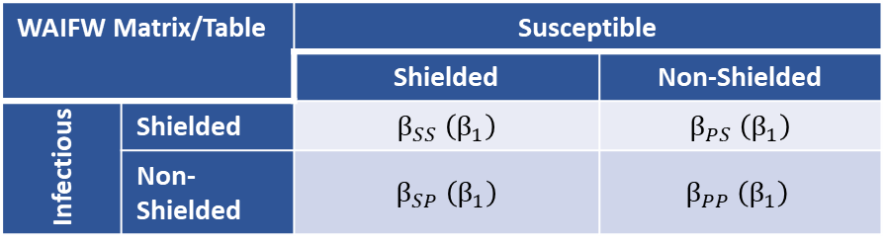

“Shielded”
Population
S_{S}
β_{SS}I_{S}S_{S}
I_{S}
Model Equations
γI_{S}
β_{SP}I_{P}S_{S}
$$\frac{dS_{S}}{dt}=−β_{SS}I_{S}S_{S}−β_{SP}I_{P}S_{S}$$
$$\frac{dS_{P}}{dt}=−β_{PP}I_{P}S_{P}−β_{PS}I_{S}S_{P}$$
$$\frac{dI_{S}}{dt}=β_{SS}I_{S}S_{S}+β_{SP}I_{P}S_{S}−γI_{S}$$
$$\frac{dI_{P}}{dt}=β_{PP}I_{P}S_{P}+β_{PS}I_{S}S_{P}−γI_{P}$$
$$\frac{dR}{dt}=γI_{S}+γI_{P}$$
β_{PS}I_{S}S_{P}
R
“non-Shielded”
Population
S_{P}
I_{P}
γI_{P}
β_{PP}I_{P}S_{P}
WAIFW Matrix/Table |  | Susceptible
 |  | Shielded | Non-Shielded
Infectious | Shielded | $β_{SS}$ $\left(β_{1}\right)$ | $β_{PS}$ $\left(β_{1}\right)$
 | Non-Shielded | $β_{SP}$ $\left(β_{1}\right)$ | $$β_{PP} \left(β_{1}\right)$$
Baseline
Where the 2nd subscript indicates the “infectious” population and the 1st subscript indicates the “susceptible” population.
WAIFW Matrix/Table |  | Susceptible
 |  | Shielded | Non-Shielded
Infectious | Shielded | $β_{SS}$ $\left(β_{1}\right)$ | $β_{PS}$ $\left(β_{2}\right)$
 | Non-Shielded | $β_{SP}$ $\left(β_{1}\right)$ | $$β_{PP} \left(β_{2}\right)$$
During the
Intervention (24 Weeks)
β1 < β2

Slide 2
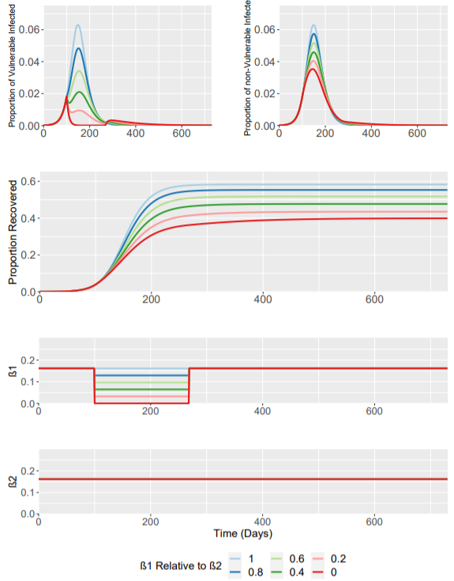
β1 Relative to β2 | β1 Value | Fraction Infected at Peak |  | Time of Epidemic Peak |  | Total Fraction Infected
 |  | Vulnerable | Non-Vulnerable | Vulnerable | Non-Vulnerable | Vulnerable | Non-Vulnerable
1 | 0.16 | 0.063 | 0.063 | 149 Days | 149 Days | 0.583 | 0.583
0.8 | 0.13 | 0.048 | 0.057 | 152 Days | 150 Days | 0.492 | 0.564
0.6 | 0.10 | 0.034 | 0.051 | 154 Days | 150 Days | 0.390 | 0.540
0.4 | 0.06 | 0.021 | 0.045 | 155 Days | 150 Days | 0.284 | 0.511
0.2 | 0.03 | 0.018 | 0.040 | 100 Days | 148 Days | 0.184 | 0.479
0 | 0 | 0.018 | 0.035 | 100 Days | 144 Days | 0.107 | 0.450
All I(t) values are relative to the population size (initial fraction) in either sub-population.
Initial Starting Population Sizes:
Vulnerable (S): 0.15
Non-Vulnerable (P): 0.85
Initial Conditions are as follows:
S_{S} | S_{P} | I_{S} | I_{P} | R
0.15 | 0.8499 | 0 | 0.0001 | 0

Slide 3
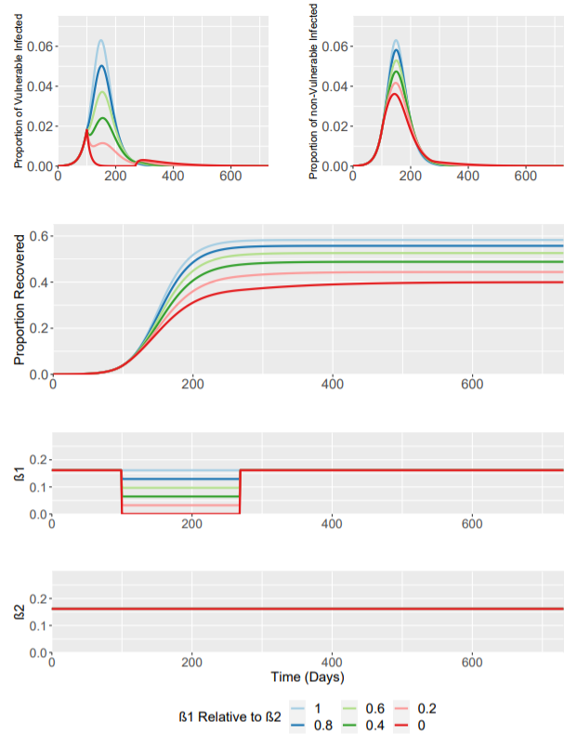
Task 1 – Interventions have no effect on within-Shielded Population Transmission (β_{SS})
β1 Relative to β2 | β1 Value | Fraction Infected at Peak |  | Time of Epidemic Peak |  | Total Fraction Infected
 |  | Vulnerable | Non-Vulnerable | Vulnerable | Non-Vulnerable | Vulnerable | Non-Vulnerable
1 | 0.16 | 0.063 | 0.063 | 149 Days | 149 Days | 0.583 | 0.583
0.8 | 0.13 | 0.050 | 0.058 | 151 Days | 150 Days | 0.505 | 0.566
0.6 | 0.10 | 0.037 | 0.052 | 153 Days | 150 Days | 0.414 | 0.546
0.4 | 0.06 | 0.024 | 0.047 | 155 Days | 150 Days | 0.312 | 0.519
0.2 | 0.03 | 0.018 | 0.042 | 100 Days | 148 Days | 0.204 | 0.486
0 | 0 | 0.018 | 0.036 | 100 Days | 144 Days | 0.109 | 0.451
We make the assumptions that interventions to shield the vulnerable groups (S) have no effect on within-population transmission in the shielded group (β_{SS})
Unlike the previous scenario: β_{SS} = β2 (0.16) during the intervention

Slide 4
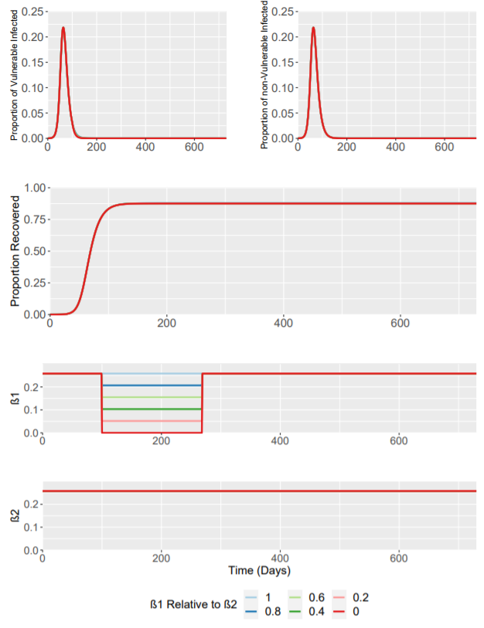
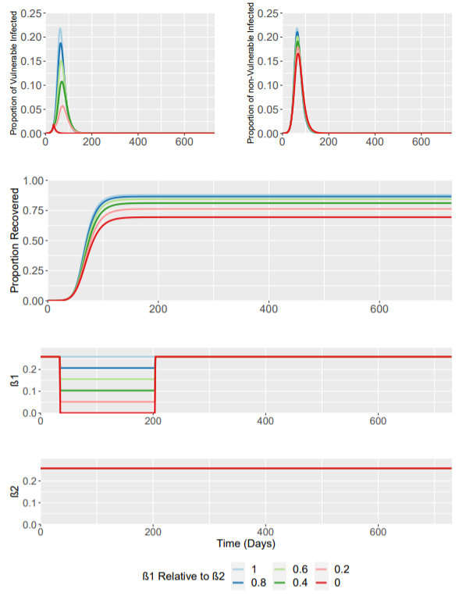
Task 2 – Limited Background Reduction to Transmission (R₀ = 2.4)
Trigger Day = 100
Trigger Day when I(t) = ~0.0182 (Day 35)
We make the assumptions that background interventions that previously reduced R0 from 2.4 to 1.5 now have NO EFFECT. R0 remains at 2.4.
Interventions to target β_{SS} and β_{SP} still have the effect of reducing the value of these parameters by their respective scaling value.

Slide 5
Task 2 – Limited Background Reduction to Transmission (R₀ = 2.4)
FOR TRIGGER DAY I(t) = ~0.0182
β1 Relative to β2 | β1 Value | Fraction Infected at Peak |  | Time of Epidemic Peak |  | Total Fraction Infected
 |  | Vulnerable | Non-Vulnerable | Vulnerable | Non-Vulnerable | Vulnerable | Non-Vulnerable
1 | 0.26 | 0.219 | 0.219 | 63 Days | 63 Days | 0.879 | 0.878
0.8 | 0.21 | 0.188 | 0.211 | 65 Days | 64 Days | 0.811 | 0.875
0.6 | 0.15 | 0.151 | 0.202 | 68 Days | 65 Days | 0.707 | 0.868
0.4 | 0.10 | 0.108 | 0.191 | 70 Days | 66 Days | 0.550 | 0.857
0.2 | 0.05 | 0.057 | 0.179 | 73 Days | 67 Days | 0.324 | 0.839
0 | 0 | 0.0185 | 0.166 | 35 Days | 67 Days | 0.032 | 0.811

Slide 6
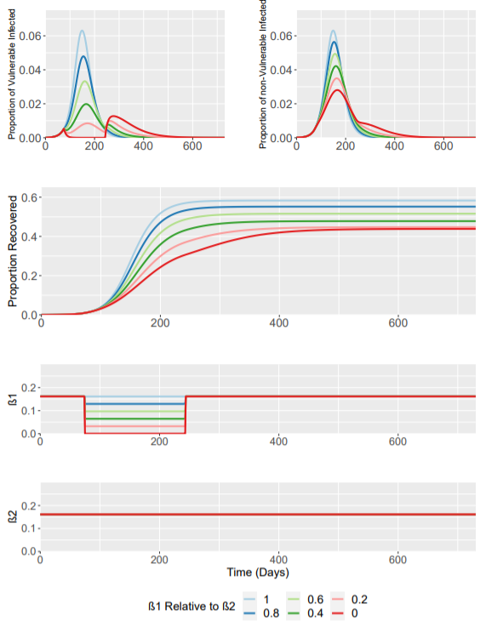
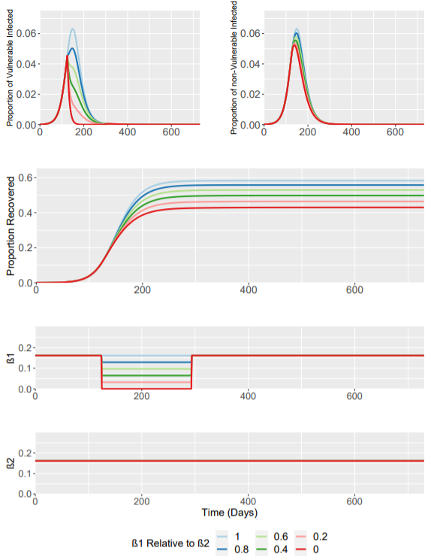
Task 3 – Altered Trigger Time for Shielded Intervention (±25 Days)
Trigger Time = 75 Days
Trigger Time = 125 Days
We alter the trigger time for the baseline intervention scenario.
With trigger times of 75 and 125 days.

Slide 7
Task 3 – Altered Trigger Time for Shielded Intervention (±25 Days)
β1 Relative to β2 | β1 Value | Fraction Infected at Peak |  | Time of Epidemic Peak |  | Total Fraction Infected
 |  | Vulnerable | Non-Vulnerable | Vulnerable | Non-Vulnerable | Vulnerable | Non-Vulnerable
1 | 0.16 | 0.063 | 0.063 | 149 Days | 149 Days | 0.582 | 0.582
0.8 | 0.13 | 0.047 | 0.056 | 155 Days | 153 Days | 0.489 | 0.563
0.6 | 0.10 | 0.033 | 0.049 | 160 Days | 157 Days | 0.386 | 0.539
0.4 | 0.06 | 0.020 | 0.042 | 166 Days | 160 Days | 0.286 | 0.512
0.2 | 0.03 | 0.010 | 0.034 | 264 Days | 164 Days | 0.212 | 0.489
0 | 0 | 0.013 | 0.028 | 277 Days | 166 Days | 0.192 | 0.482
Trigger Time = 75 Days
β1 Relative to β2 | β1 Value | Fraction Infected at Peak |  | Time of Epidemic Peak |  | Total Fraction Infected
 |  | Vulnerable | Non-Vulnerable | Vulnerable | Non-Vulnerable | Vulnerable | Non-Vulnerable
1 | 0.16 | 0.063 | 0.063 | 149 | 149 | 0.583 | 0.583
0.8 | 0.13 | 0.050 | 0.060 | 147 | 147 | 0.507 | 0.567
0.6 | 0.10 | 0.045 | 0.058 | 125 | 145 | 0.424 | 0.548
0.4 | 0.06 | 0.045 | 0.056 | 125 | 143 | 0.338 | 0.526
0.2 | 0.03 | 0.045 | 0.054 | 125 | 140 | 0.252 | 0.502
0 | 0 | 0.045 | 0.052 | 125 | 138 | 0.173 | 0.475
Trigger Time = 125 Days

